Slide 1

E-Learning
Resources for Teaching and Learning
Ideas for Review

Slide 2

WOW!
Can you believe this?
Unprecedented

Slide 3

Now What?

Slide 4
Balance

Slide 5
Collaborate/
Ask for Help:
Maureen
Kim
Kristi
AP Biology FB Group
NABT FB Group
Bio NGSS FB Group

Slide 6
Ways to Communicate
Remind
Google Classroom
Zoom
YouTube Live
Discord
Google Hangouts
Your school’s LMS

Slide 7

Videos
Clips
Screen Cast
Screencatify: https://www.screencastify.com (Coupon= CAST_COVID)
Loom
WeVideo
Other ways too
Bozeman
Amoeba Sisters
Crash Course
EdPuzzle

Slide 8
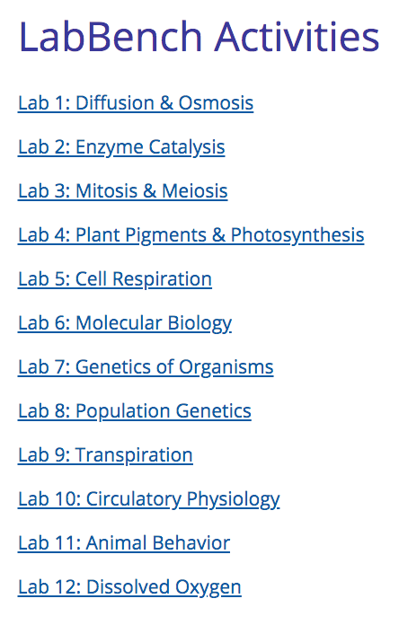
Virtual Labs
Lab Bench:
http://www.phschool.com/science/biology_place/labbench/index.html

Slide 9
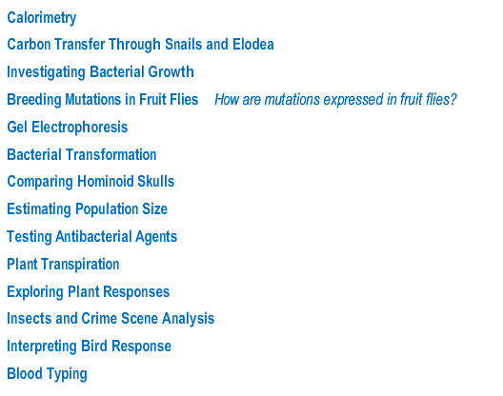
Virtual Labs
Classzone:
http://www.classzone.com/cz/books/bio_07/resources/htmls/virtual_labs/virtualLabs.html

Slide 10
Photosynthesis:
https://www.northernhighlands.org/cms/lib5/NJ01000179/Centricity/Domain/38/photosynthesis-virtual-labs.pdf
Photosynthesis:
https://www.wlwv.k12.or.us/cms/lib/OR01001812/Centricity/Domain/1338/WEBQUEST%20-%20Photosynthesis%20Virtual%20Labs_NM_NEW.pdf
Photosynthesis:
https://www.saultschools.org/cms/lib/MI17000143/Centricity/Domain/222/Photosynthesis%20Virtual%20Lab.html

Slide 11
Bacterial Transformation:
http://ogobio.weebly.com/uploads/3/2/3/9/3239894/bacterial-transformation-lab-6a-virtual-lab.pdf
Plant Transpiration:
http://glencoe.mheducation.com/sites/dl/free/0078695104/383946/BL_10.html
Osmosis:
https://video.esc4.net/video/assets/Science/Biology/Gateway%20Resources/cell%20homeostasis%20virtual%20lab%20-%20activity/index.html

Slide 12
Enzymes:
https://glencoe.mheducation.com/sites/dl/free/0078802849/383930/BL_11.html
Enzymes:
https://www.biologycorner.com/worksheets/enzyme-lab-virtual.html

Slide 13
NY Times
What’s Going On With This Graph?
https://www.nytimes.com/column/whats-going-on-in-this-graph?fbclid=IwAR3T6-0bwDPBmuQsXY1pFuYcuBgsb8uPn3g_c9sxljbDfSczl6Dmnmr_OgI
CER:
https://docs.google.com/document/d/1wVIvasK_4spVF4HFMbrv4KpLiXuwriM4eOhyAm5nMRI/edit

Slide 14
HHMI Resources
Click and Learn:
Cell Cycle
Central Dogma and Genetic Medicine
Crisp CAS 9
Understanding Global Change
Genetic Mutation and Disease
Videos:
Got Lactase?
Biology of Skin Color
Rock Pocket Mice
The Beak of the Finch
Natural Selection in Humans
Evolving Bodies and the Stickleback

Slide 15
Review for AP Test
2013 Practice Test
AP Classroom
Study Book
POGILS
HHMI
Albert IO, Shmoop, Other

Slide 16
What did we rush through?
Water Potential
Protein Structure
Cellular Respiration
Photosynthesis
Chi Square
Error Bars
Experimental Design
FRQ Task Words
What do I know we always need to review?What did we rush through?
What was a weak area for my kids this year?

Slide 17
Kristi Phillippe
kphillippe@marion.k12.in.us
Maureen McGrail
mmcgrail@nd.edu

